Slide 1
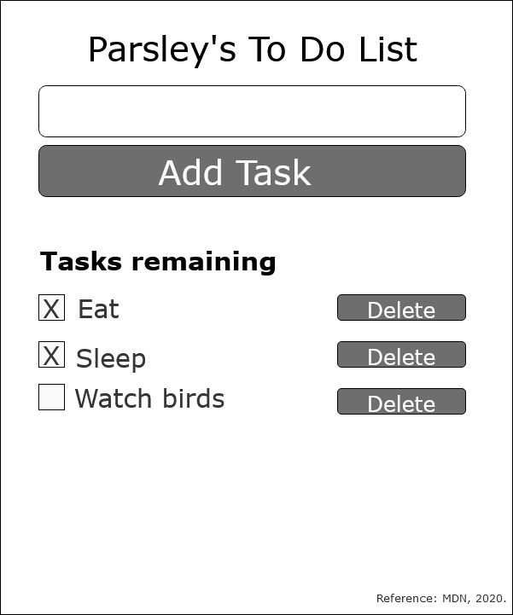
React To-Do Planning Assignment
In React, a component is a reusable module that renders a part of our app.

Slide 2
1
The Main Container of To-Do Task – This container component will show page for the user. This container include components: input task form, add task button, task list, delete buttons (Fesehatsion, 2019).
1
Input Form Component – This should allow user to input task. This contain functional components to just receive props as arguments and return JSX to be rendered. This component will only have one prop to handle the click event for adding a new to-do (Nwamba, 2016).
2
To-Do Component – This component should include <ul> that contains a loop of to-do components made of <li> (Nwamba, 2016).
To-Do List Component:
The “Delete” property is an even handler that will be called when the item is clicked. The purpose is to delete a task when it is click. This will be taken care of in the container component (Nwamba, 2016).
The only the “delete” property can be passed in to it’s to the To-Do Component via it’s parent (Nwamba 2016).
5
4
3
Completed Component – This should be a simple component to hold true or false to determine whether it has been completed or not (MDN, 2020a).

Slide 3
Initializing my To-Do app (MDN, 2020b).
Install npm packages such as npx create-react-app moz-todo-react.
Initialize npm start.

Slide 4
How Each Components are Linked
A visual description of a functioning To-Do application using arrows and pseudocode.

Slide 5
Step 1: User input.
User input task such as “eat”, “sleep”, “grooming”, etc.

Slide 6
Breakdowns (Pseudocode)

